Slide 1


FACULTY BAR
Performance Evaluation of Computer Systems and Networks
Diego Casu
Iacopo Pacini

Slide 2



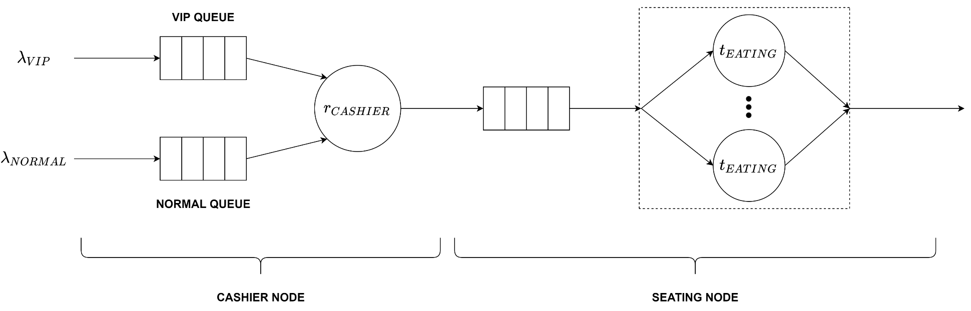



Description and modeling
VIP & NORMAL CUSTOMERS
CASHIER
TABLES
Objectives:
analysis of waiting and response times;
analysis and dimensioning of queues.
CONSTANT & EXPONENTIAL
SCENARIOS

Slide 3

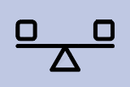

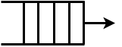

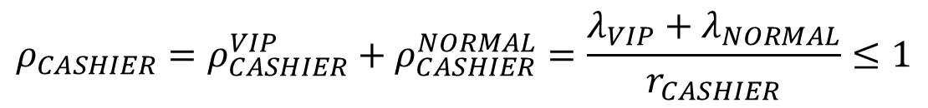
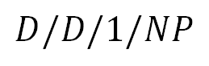
Cashier: stability and queues
$$D/D/1/NP$$
$$ρ_{CASHIER}=ρ_{CASHIER}^{VIP}+ρ_{CASHIER}^{NORMAL}=\frac{λ_{VIP}+λ_{NORMAL}}{r_{CASHIER}}≤1$$
If stable, it is always in steady state and at any time:
at most one queue out of two is occupied;
at most one single customer can reside in a queue, regardless of the membership.
$K_{q, CASHIER}^{VIP}{=K}_{q, CASHIER}^{NORMAL}=1$ is a worst case dimensioning.
CONSTANT
SCENARIO

Slide 4
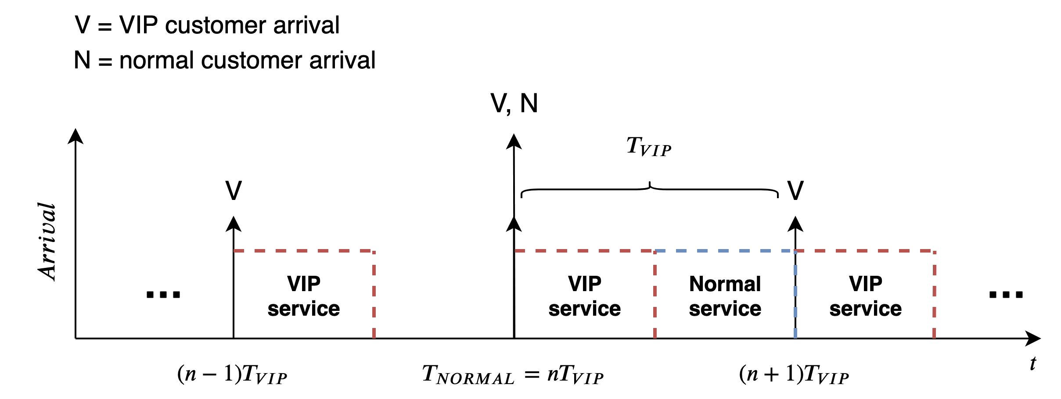
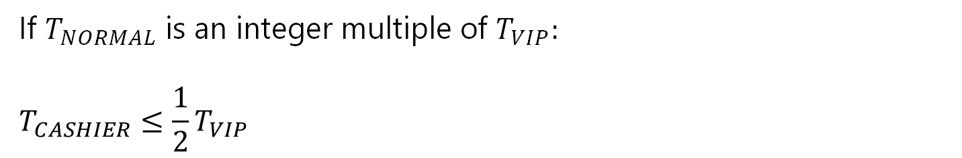
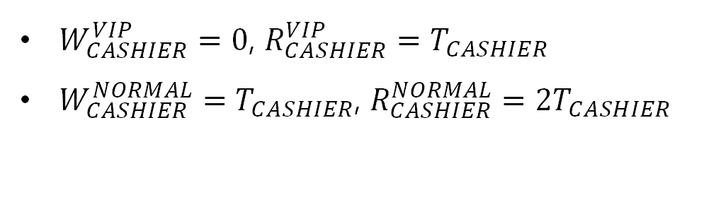
Waiting and response times (1)
If $T_{NORMAL}$ is an integer multiple of $T_{VIP}:$
$$T_{CASHIER}≤\frac{1}{2}T_{VIP}$$
$W_{CASHIER}^{VIP}=0$, $R_{CASHIER}^{VIP}=T_{CASHIER}$
$W_{CASHIER}^{NORMAL}=T_{CASHIER}$, $R_{CASHIER}^{NORMAL}={2T}_{CASHIER}$
CONSTANT
SCENARIO

Slide 5
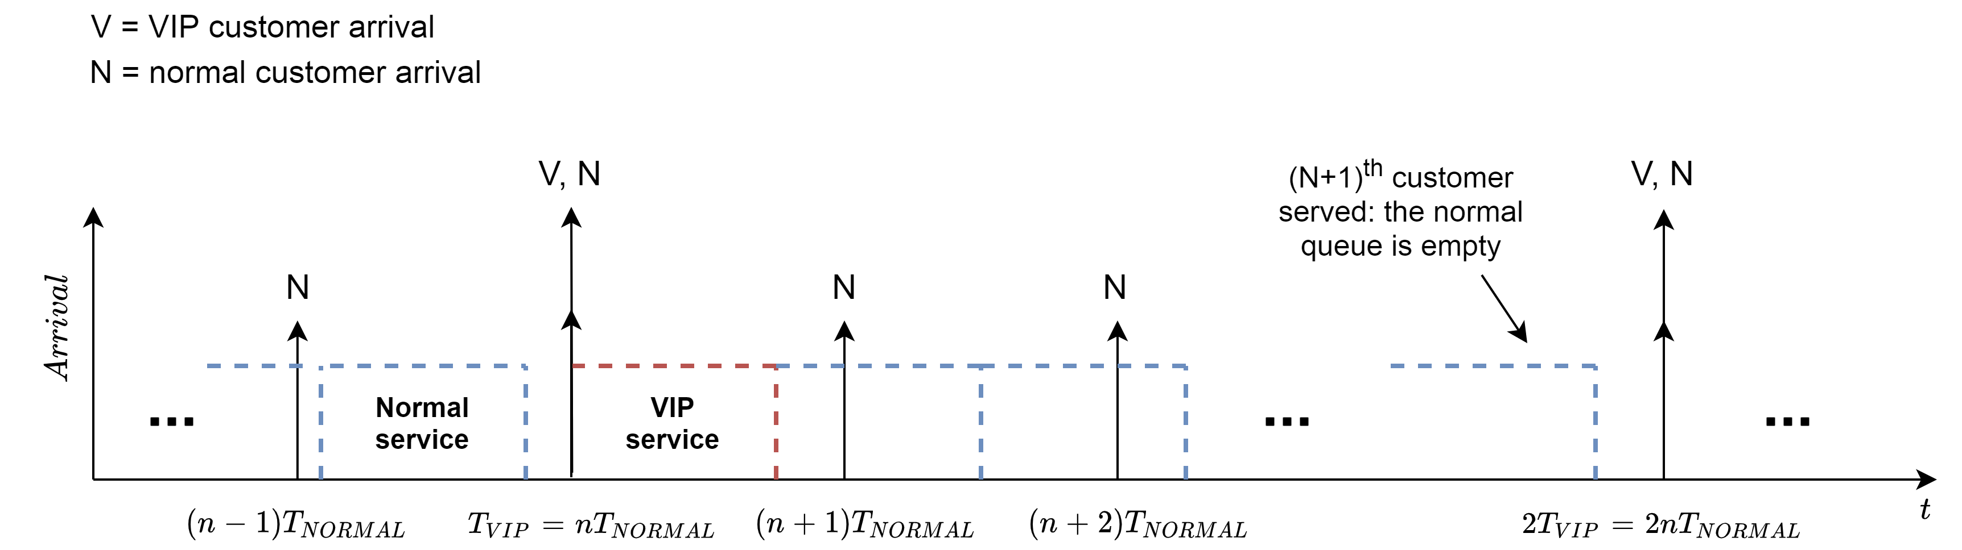
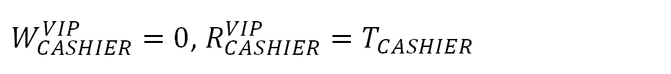
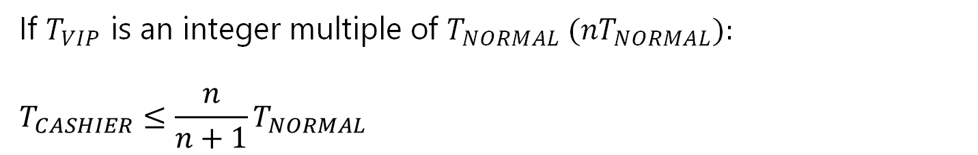
Waiting and response times (2)
If $T_{VIP}$ is an integer multiple of $T_{NORMAL} (nT_{NORMAL}):$
$$T_{CASHIER}≤\frac{n}{n+1}T_{NORMAL}$$
$W_{CASHIER}^{VIP}=0$, $R_{CASHIER}^{VIP}=T_{CASHIER}$
CONSTANT
SCENARIO

Slide 6
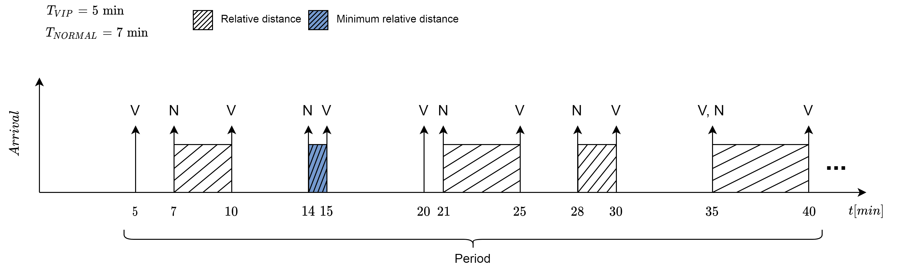
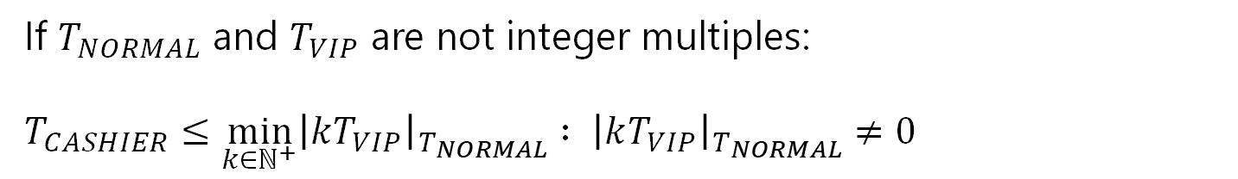

Waiting and response times (3)
If $T_{NORMAL}$ and $T_{VIP}$ are not integer multiples:
$$T_{CASHIER}≤\min_{k∈ℕ^{+}}{{\left|kT_{VIP}\right|}_{T_{NORMAL}}} : {\left|kT_{VIP}\right|}_{T_{NORMAL}}≠0$$
$W_{CASHIER}^{VIP}=0$, $R_{CASHIER}^{VIP}=T_{CASHIER}$
CONSTANT
SCENARIO

Slide 7

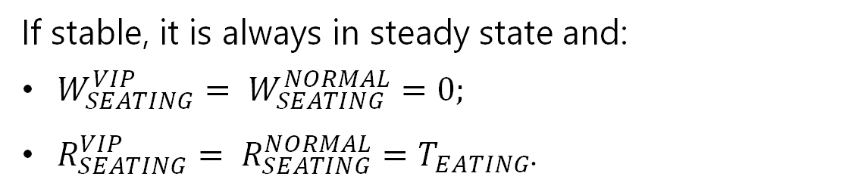
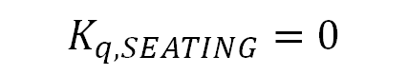

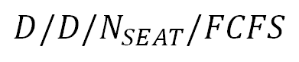
Seating node
$$D/D/N_{SEAT}/FCFS$$
$$ρ_{SEATING}=\frac{λ_{VIP}+λ_{NORMAL}}{N_{SEAT}∙t_{EATING}}≤1$$
If stable, it is always in steady state and:
$W_{SEATING}^{VIP}= W_{SEATING}^{NORMAL}=0;$
$R_{SEATING}^{VIP}= R_{SEATING}^{NORMAL}=T_{EATING}$.
$$K_{q, SEATING}=0$$
CONSTANT
SCENARIO

Slide 8

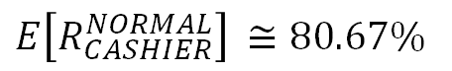
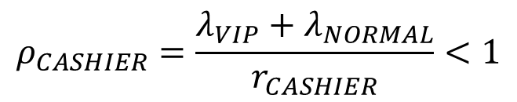
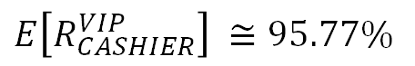
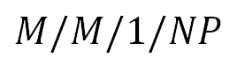
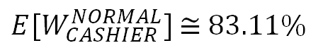
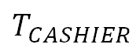
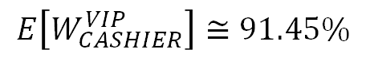
Cashier: stability and $2^{k}r$analysis
$$M/M/1/NP$$
$$ρ_{CASHIER}=\frac{λ_{VIP}+λ_{NORMAL}}{r_{CASHIER}}<1$$
$T_{VIP}{, T}_{NORMAL}∈[5.5min, 10min]$, $T_{CASHIER}∈[1min, 2.5min]$
$$E\left[W_{CASHIER}^{VIP}\right]≅91.45\%$$
$$E\left[R_{CASHIER}^{VIP}\right] ≅95.77\%$$
$$T_{CASHIER}$$
$E[W_{CASHIER}^{NORMAL}]$ $≅$ $83.11\%$
$E\left[R_{CASHIER}^{NORMAL}\right]$ $≅80.67\%$
EXPONENTIAL
SCENARIO

Slide 9
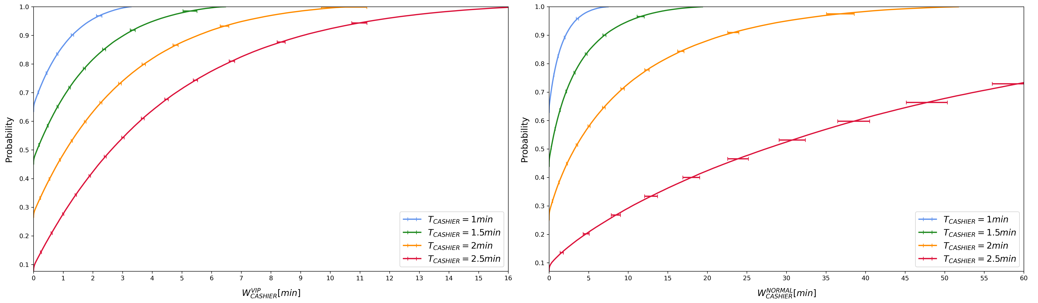
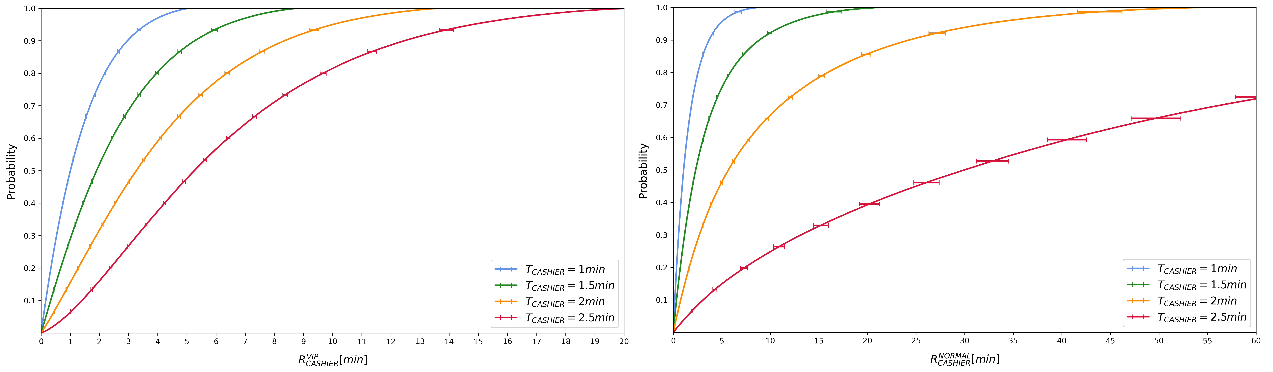
Waiting and response times
Asymmetric growth with the utilization VIP advantage.
Great unfairness between classes when the system approaches saturation.
EXPONENTIAL
SCENARIO

Slide 10
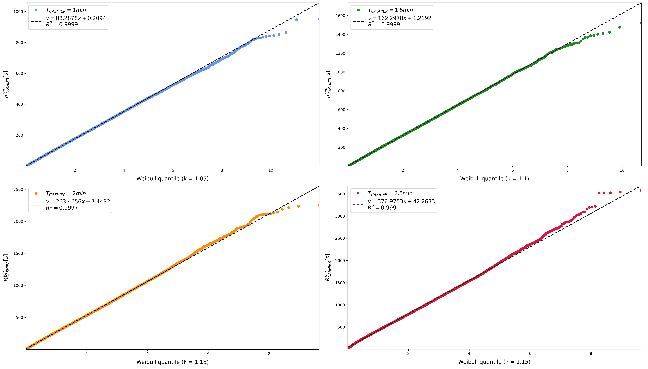
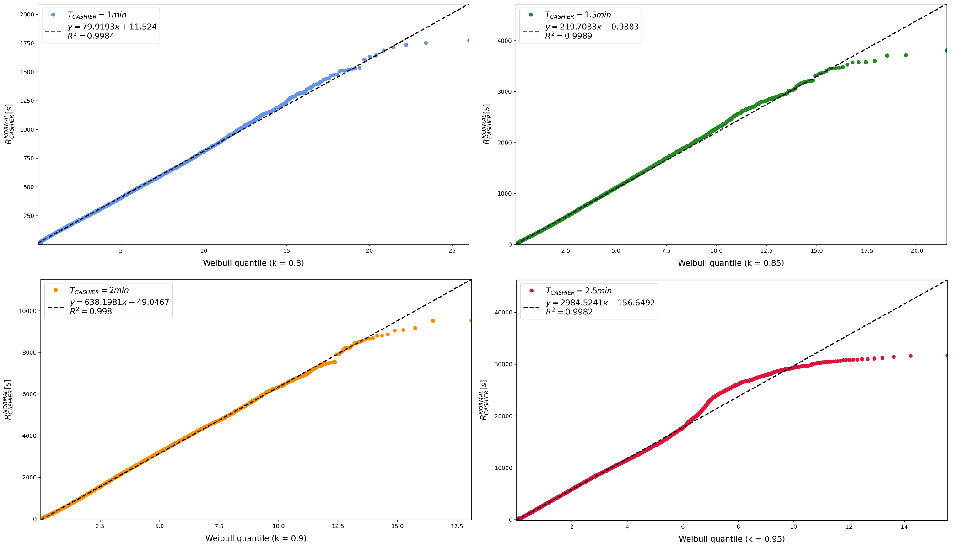
Response times: fitting
EXPONENTIAL
SCENARIO

Slide 11
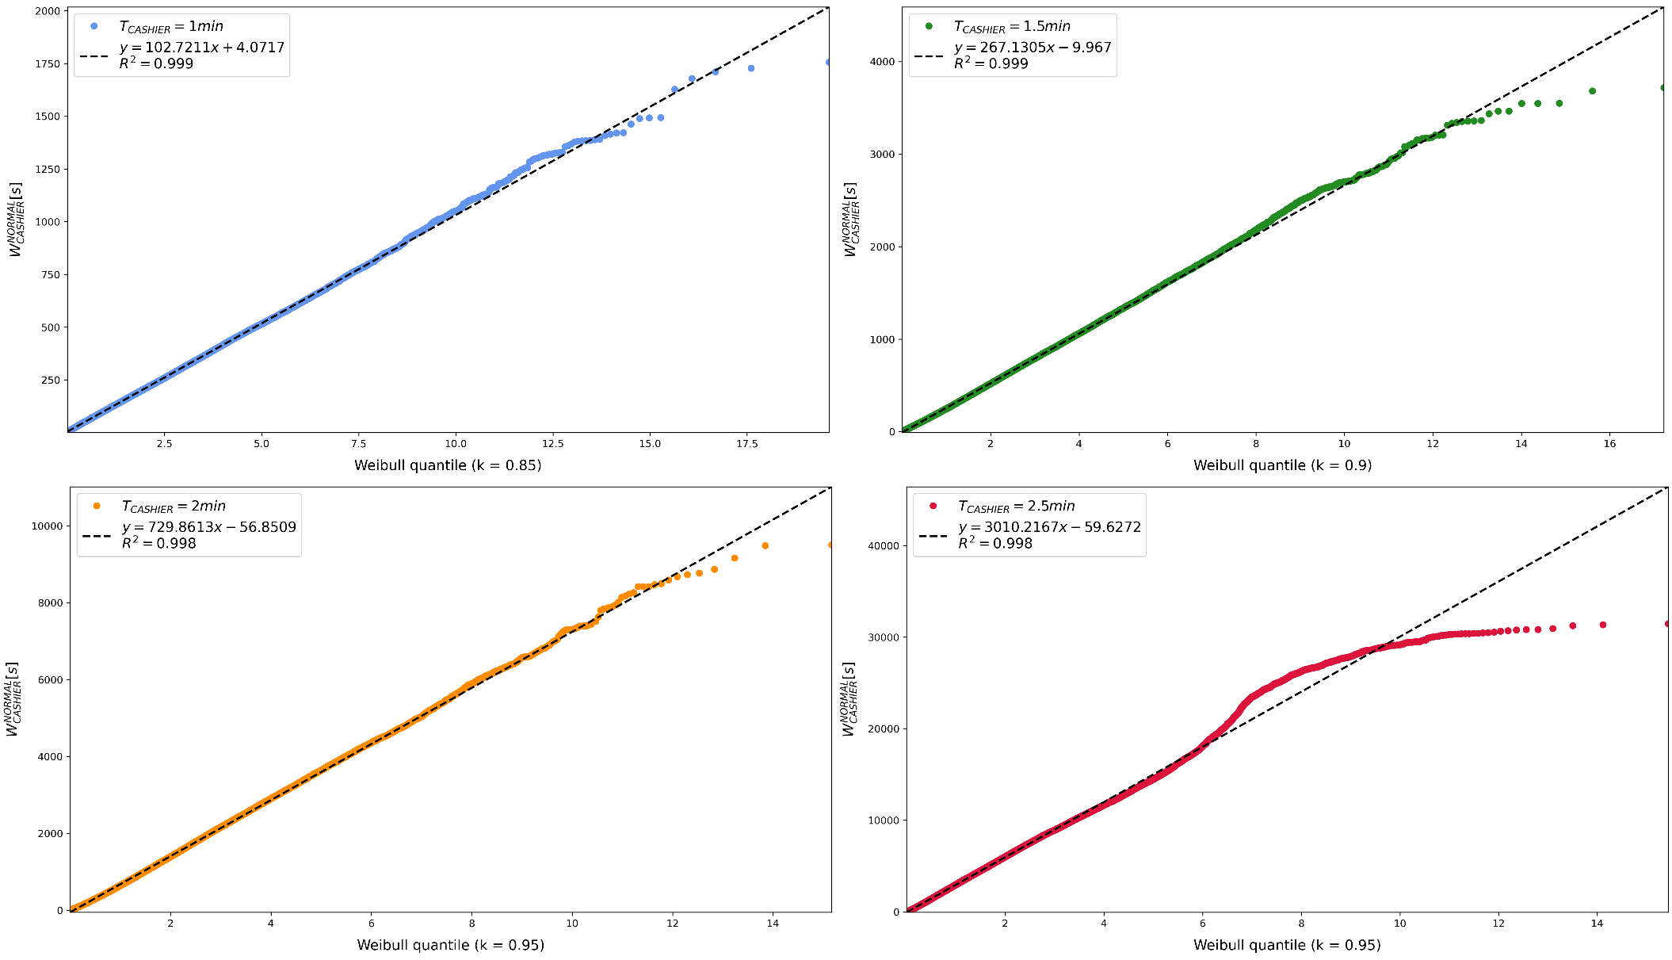
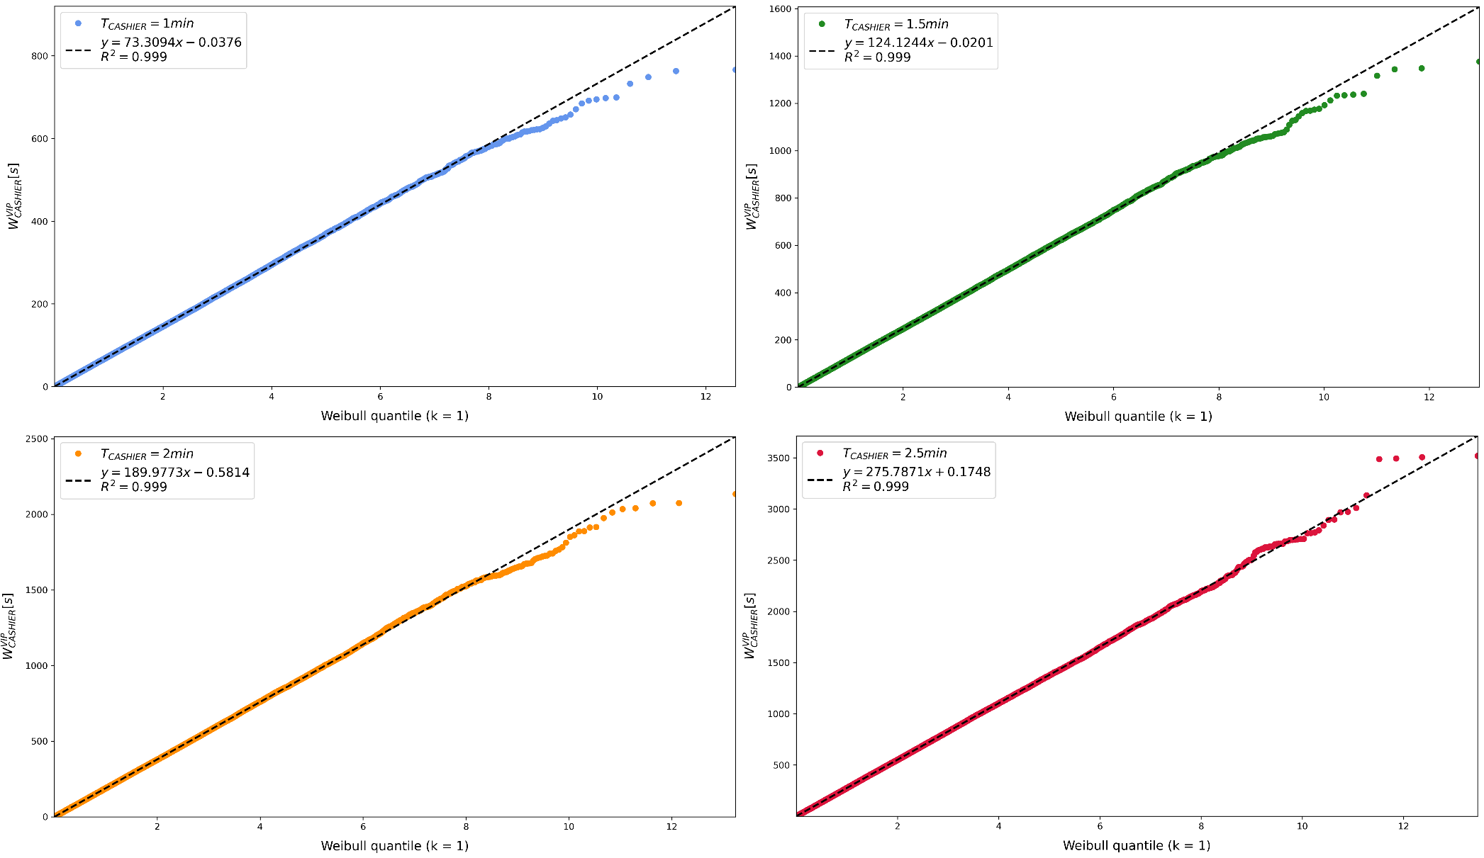
Waiting times: fitting
EXPONENTIAL
SCENARIO

Slide 12
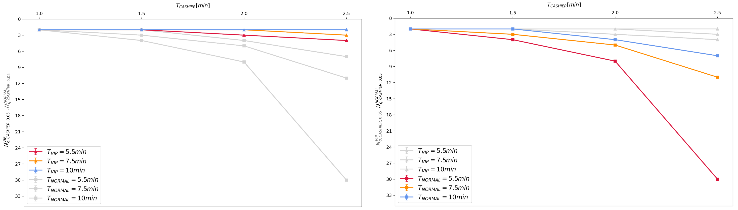
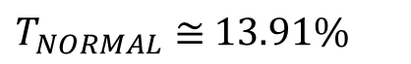
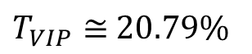
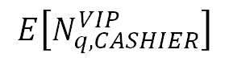
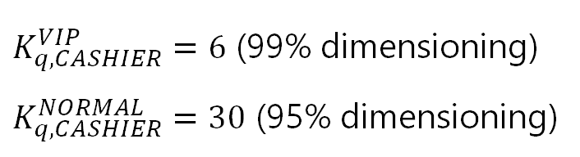
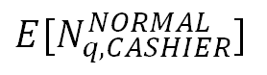
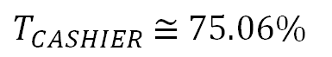
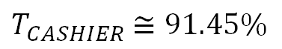
Queue occupancy (1)
$T_{VIP}{, T}_{NORMAL}∈[5.5min, 10min]$, $T_{CASHIER}∈[1min, 2.5min]$
$T_{CASHIER}$ $≅91.45\%$
$$E\left[N_{q,CASHIER}^{VIP}\right]$$
$T_{VIP}≅$ $20.79\%$
$T_{CASHIER}$ $≅$ $75.06\%$
$$E[N_{q,CASHIER}^{NORMAL}]$$
$T_{NORMAL}≅$ $13.91\%$
$K_{q,CASHIER}^{VIP}=6$ (99% dimensioning)
$K_{q,CASHIER}^{NORMAL}=30$ (95% dimensioning)
EXPONENTIAL
SCENARIO

Slide 13
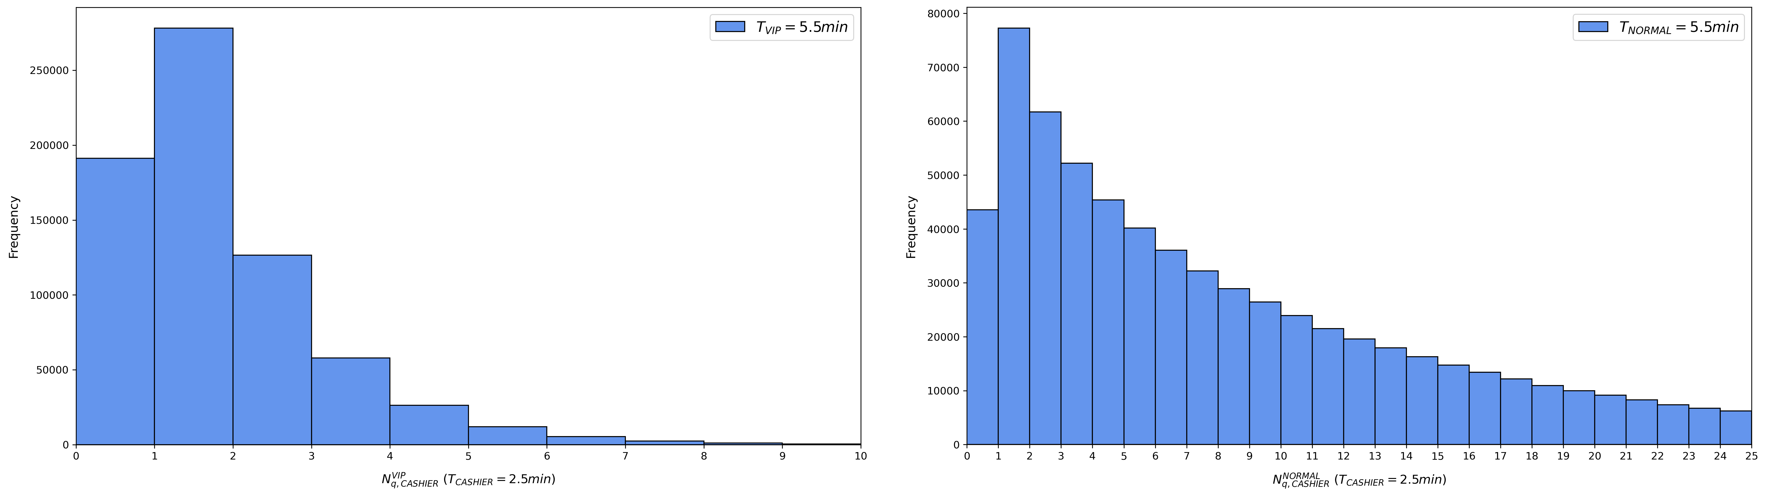

Queue occupancy (2)
IoD > 1.
Early peak it is not a geometric distribution.
Discrete Weibull with shape > 1.
EXPONENTIAL
SCENARIO

Slide 14

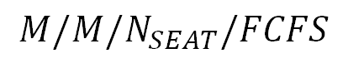
Seating node
$$M/M/N_{SEAT}/FCFS$$
$$ρ_{SEATING}=\frac{λ_{VIP}+λ_{NORMAL}}{N_{SEAT}∙t_{EATING}}<1$$
Theoretical results are available for such a system, both with infinite and finite queues.
EXPONENTIAL
SCENARIO

Slide 15
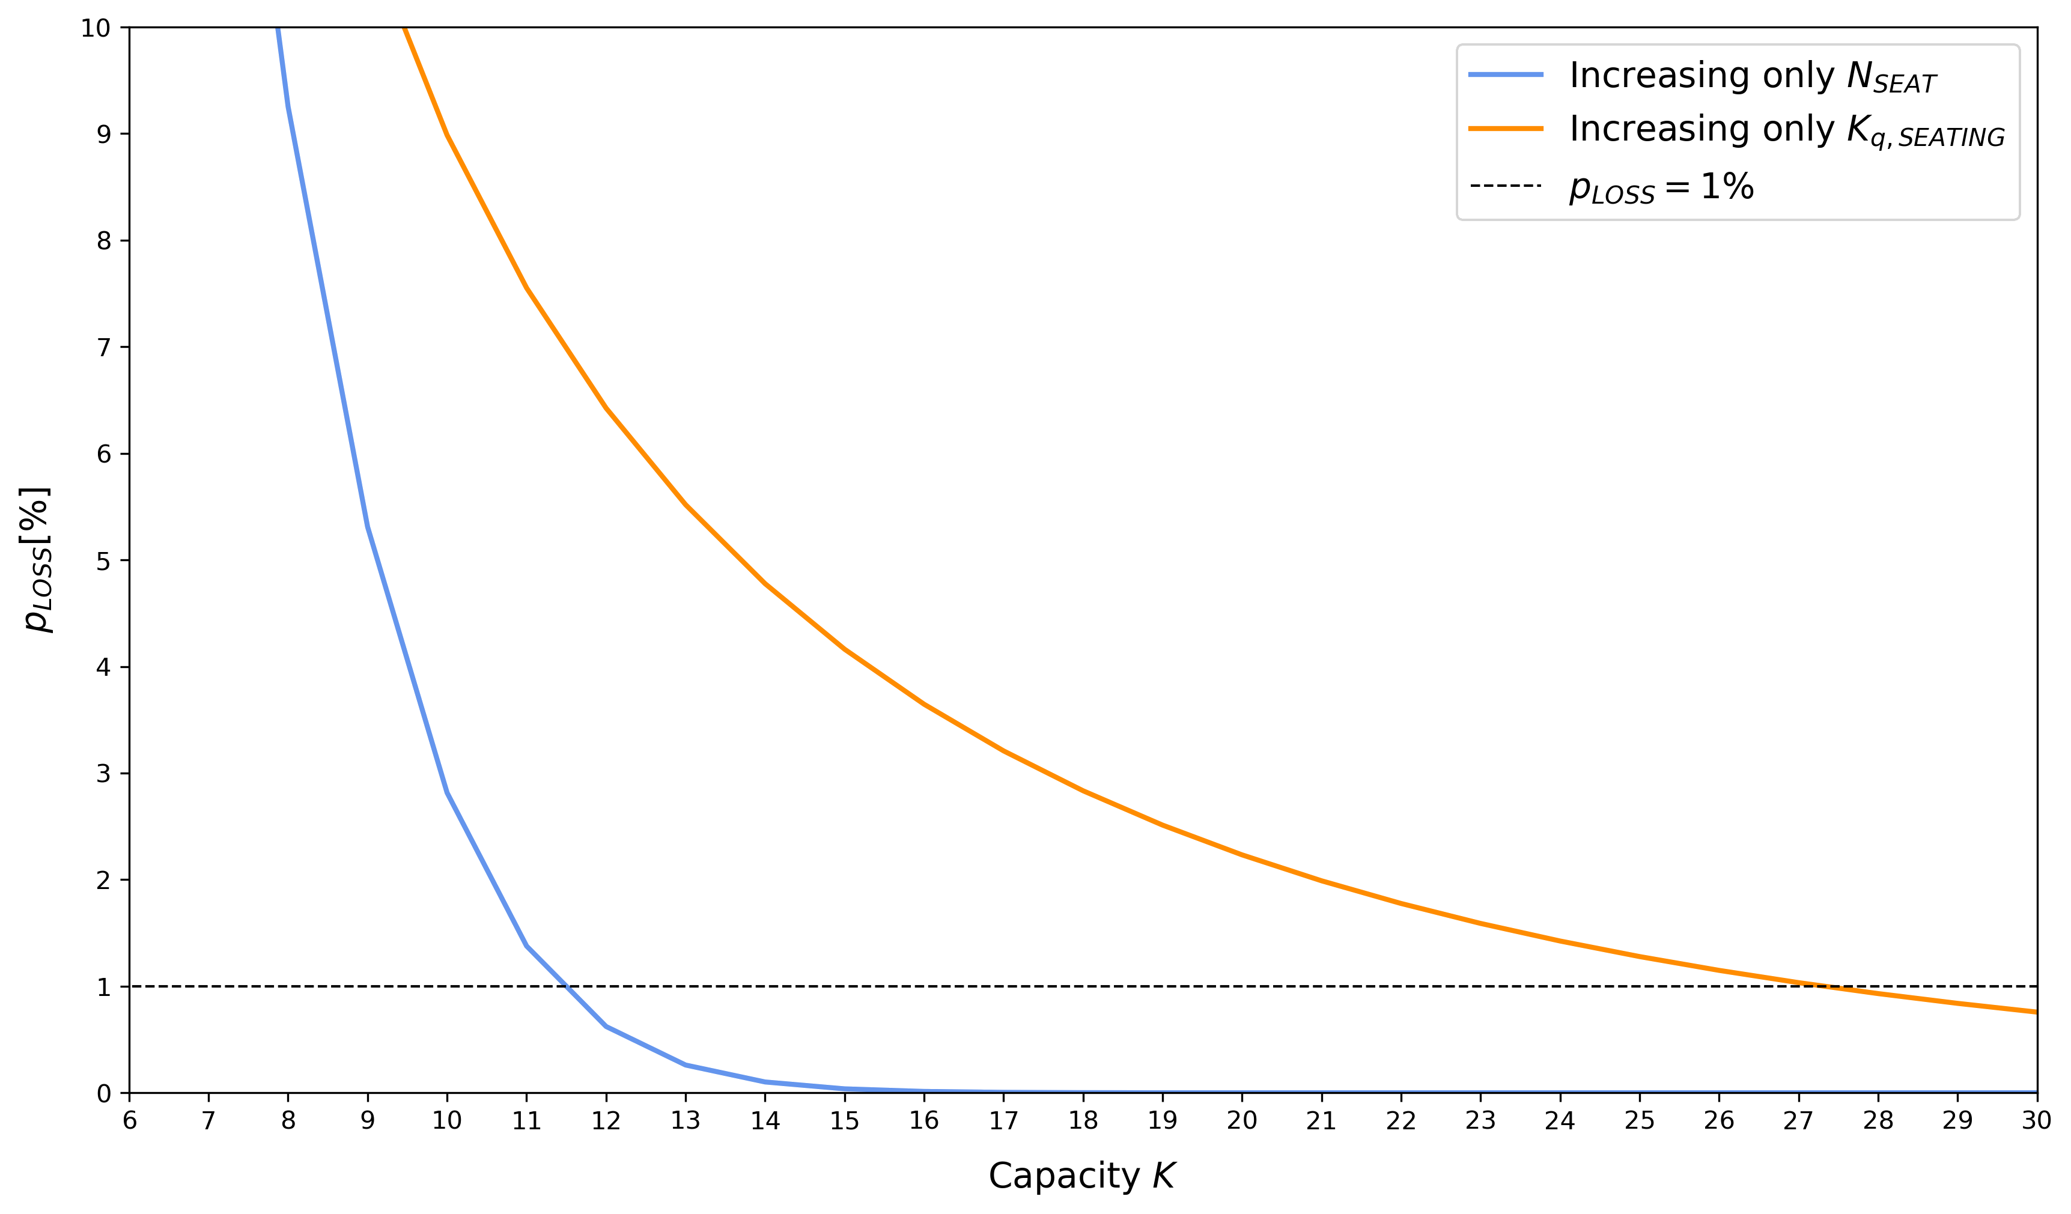
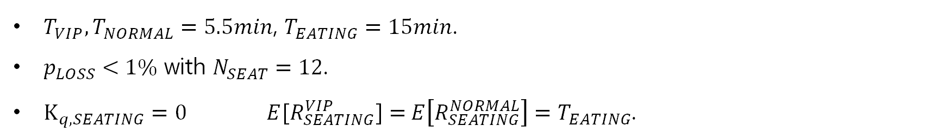
Worst case dimensioning
$T_{VIP},T_{NORMAL}=5.5min$, $T_{EATING}=15min$.
$p_{LOSS}<1\%$ with $N_{SEAT}=12$.
$K_{q,SEATING}=0 E[R_{SEATING}^{VIP}]={ E\left[R_{SEATING}^{NORMAL}\right]=T}_{EATING}$.
EXPONENTIAL
SCENARIO

